Slide 1

FRUITS TO INCREASE LIBIDO

Slide 2
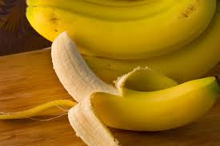
BANANA: reverses impotence & increase the body’s overall energy

Slide 3
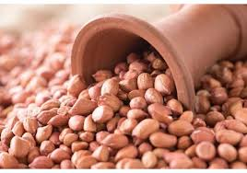
Groundnuts: quality of sperms

Slide 4

Chocolate: pumps up the passion

Slide 5
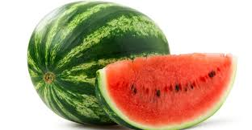
Watermelon: relax blood vessels and revives up sex drive

Slide 6
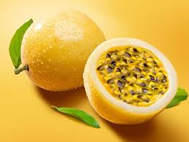
Passion: gives sexual stamina and helps with vaginal dryness

Slide 7
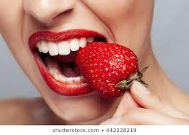
Strawberry: loaded with zinc which is essensntial for sex

Slide 8
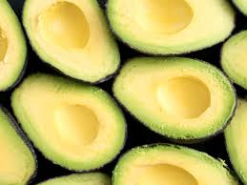
Avocado: vitamin b6 to keep your energy up

Slide 9
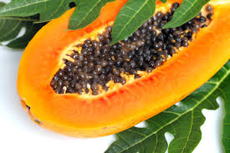
Papaya: eating it prior to sex heightens enegry levels

Slide 10
Let him kiss me with the kisses of his mouth for your love is more delightful than wine
Song of songs1:2

